Slide 1
Effective Detection of Multimedia Protocol Tunneling using Machine Learning
USENIX SECURITY ‘ 18
DIOGO BARRADAS, NUNO SANTOS, LUIS RODRIGUES

Slide 2
Content
Key Idea of This Paper
Background
Existing Metrics
Similarity-based Classification
New Approach
Decision Tree-based Classification
Beyond Supervised Anomaly Detection
Discussion

Slide 3
Problem
Covert channels should be unobservable
However, the evaluation of existing systems is done by ad hoc methods
Are they really the secure systems?

Slide 4
Contribution
Existing Decision-Tree based machine learning technique can break the unobservability of them
With low false positive rates
How about there is no label in the dataset?
Semi-supervised ML techniques
Unsupervised ML techniques

Slide 5
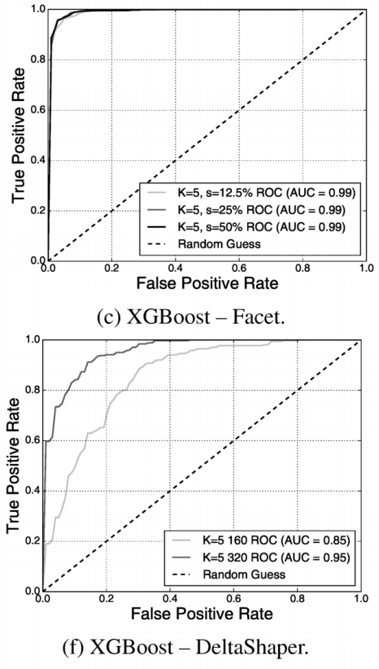
Result
Decision-Tree based ML technique successfully detects covert traffics
AUC = 0.99 for Facet
AUC = 0.85~0.95 for DeltaShaper

Slide 6
Meaning of the Paper
It shows that some state-of-the-art multimedia protocol tunneling tools are flawed
It figured out which network features are important to detect covert channels.
It shows that the labeled dataset is a required for the successful detection of covert channels

Slide 7
Target Systems
Three state-of-the-art systems
Facet, CovertCast, DeltaShaper
Encodes data into video streams
Their code is publicly available

Slide 8
Target System: Facet
Allows clients to watch desired video
by replacing audio/video of Skype videocalls
Desired video fraction on typical videocall stream
decreasing fraction ratio (s) means that increasing resistance against traffic analysis
Collected 1000 YouTube Top Liked playlist (for covert)
Collected 1000 legitimate recorded live chat videos (Skype, for legitimate)
Used parameters: s=50%, 25%, 12.5%
Camera resolution: 320 X 240

Slide 9
Target System: CovertCast
Modulates web content by encoding it into colored matrix images and stream it via stream services like YouTube
Clients demodulate the images given through stream and get the web contents
Crawled 200 live-streams from YouTube
Generated 200 CovertCast live-streams
Resolution: 1280 X 720

Slide 10
Target System: DeltaShaper
Facet + CovertCast
Using bi-directional Skype videocall
Encode data into images and transmit it
Encoded data (colored matrix) is overlayed
in a fraction of the call screen
on top of a typical chat video
Parameter: <Payload frame area, cell size, number of bits, framerate>
Used <320 X 240, 8 X 8, 6, 1>, <160 X 120, 4 X 4, 6, 1>
Resolution: 640 X 480

Slide 11
Adversary Model
State-level adversary
will attempt to detect the covert traffic
Providers of encrypted multimedia apps are not assumed to collude with the adversary
ex: YouTube service provider will not give the raw multimedia content of arbitrary video
Adversary cannot control end-user’s computer
But domestic ISPs will cooperate with adversary
So that the adversary can monitor the traffic

Slide 12
Pearson’s Chi-squared Test (χ2)
Is two variables differ significantly?
By comparing the observed & expected frequencies
Metric used in evaluating Facet
Used bi-gram distribution of packet lengths
some extreme bi-grams are discarded

Slide 13
KL(Kullback-Leibler) Divergence
Measuring relative entropy between two targets
By computing the information lost
When trying to approximate one dist. with the other
Metric used for building a classifier for CovertCast
Two target distributions
YouTube videos carrying modulated data
YouTube videos which are legitimate

Slide 14
Earth Movers’ Distance (EMD)
Measures the dissimilarity between two dist.
Distance between single features defined in a matrix
Metric used for building classifier for DeltaShaper
Comparing quantized frequency dist. of packetlen.

Slide 15
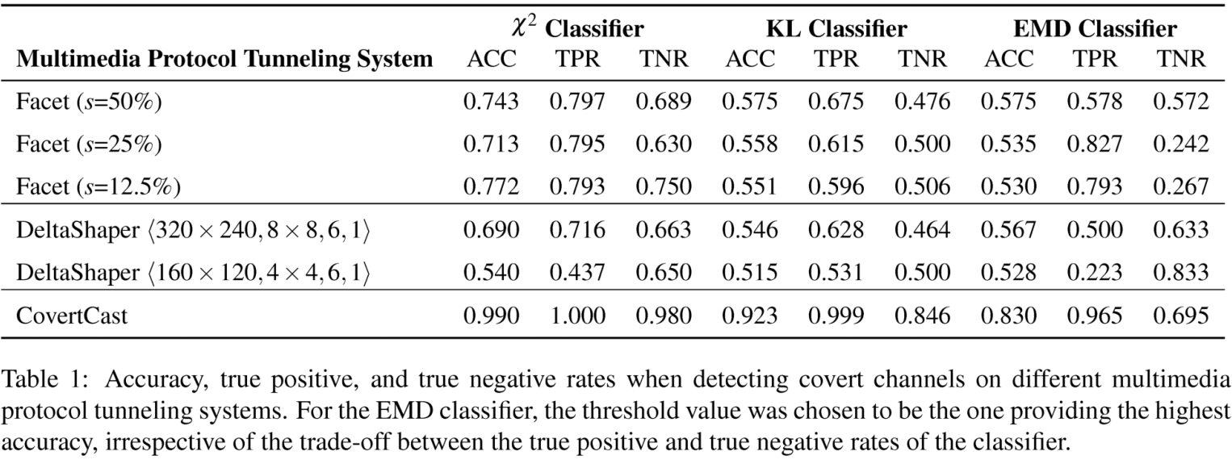
Results & Findings
Unobservability Guranteed

Slide 16
Results & Findings
χ² Outperforms Other Classifiers

Slide 17
Results & Findings
CovertCast Failed to Guarantee Unobservability

Slide 18
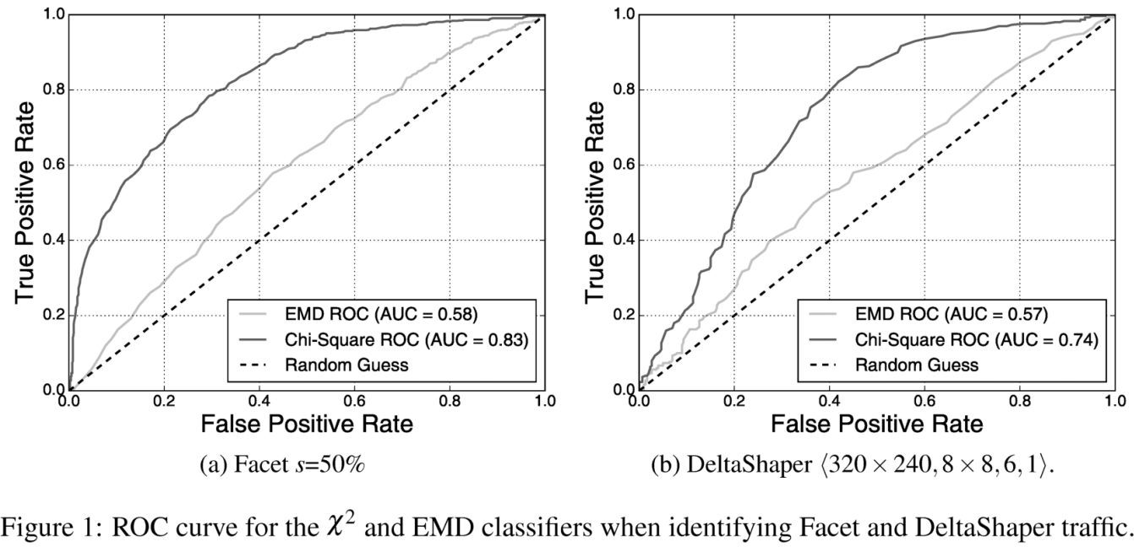
Results & Findings
0.9
0.9
0.45
0.51
χ² Produces Large False Positive Rates (Facet, DeltaShpaer)

Slide 19
Decision-Tree Based Classification
Decision Trees (DT)
Each tree node is either a decision or leaf node
Decision node split the current branch by an attribute
Random Forests (RF)
An ensemble learning method
select result from a majority vote of multiple DTs
eXtreme Gradient Boosting (XGBoost)
Creates a new tree which optimizes the predictions
Has a benefit to control overfitting

Slide 20
Feature Sets
Summary Statistics (ST)
A timeseries of packet lengths
A timeseries of packet inter-arrival times
Burst behavior
Quantized Packet Lengths (PL)
Quantized frequency distribution of packet lengths

Slide 21
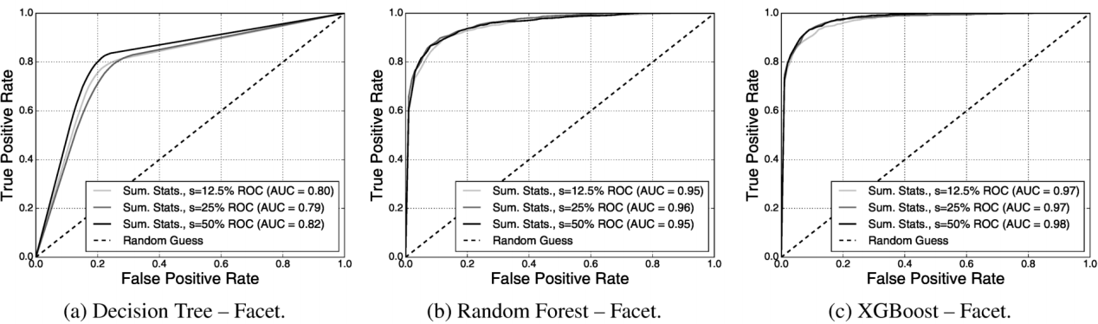
Results & Findings - Facet
ROC curves w/ Feature Set 1: Summary Statistics
Min. AUC = 0.95
Min. AUC = 0.97
(Max. AUC of χ² = 0.85)
Random Forest/XGBoost Breaks Unobservability

Slide 22
Results & Findings - Facet
ROC curves w/ Feature Set 1: Summary Statistics
0.9
0.9
0.141
0.071
Low False Positive Rates

Slide 23
Results & Findings - Facet
ROC curves w/ Feature Set 1: Summary Statistics
0.7
0.01
Low False Positive Rates

Slide 24
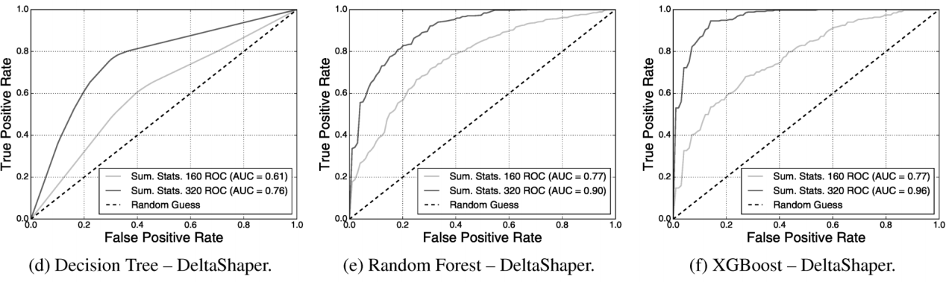
Results & Findings - DeltaShaper
ROC curves w/ Feature Set 1: Summary Statistics
AUC is 0.22 larger than AUC of χ²
for both configurations
Random Forest/XGBoost Breaks Unobservability

Slide 25
Results & Findings - DeltaShaper
ROC curves w/ Feature Set 1: Summary Statistics
0.9
0.9
0.303
0.121
Low False Positive Rates

Slide 26
Results & Findings - DeltaShaper
ROC curves w/ Feature Set 1: Summary Statistics
0.7
0.04
Low False Positive Rates

Slide 27
Results & Findings - CovertCast
Omitted
All of these techniques identify its covert traffic
With a negligible false positive rate
There’s no reason to omit this because of above
I think the reason should be:
“The existing metrics are enough to identify its covert channel.”

Slide 28
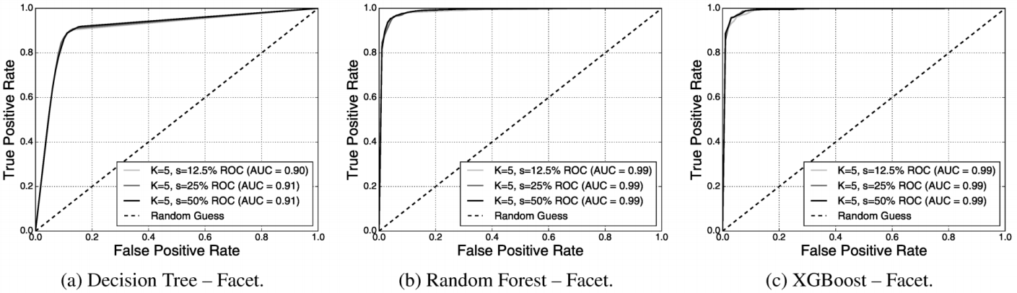
Results & Findings - Facet
ROC curves w/ Feature Set 2: Quantized PLs
AUC = 0.91
AUC = 0.99
(+0.04 than ST)
AUC = 0.99
(+0.02 than ST)
Quantized PLs Outperform the use of Summary Statistics

Slide 29
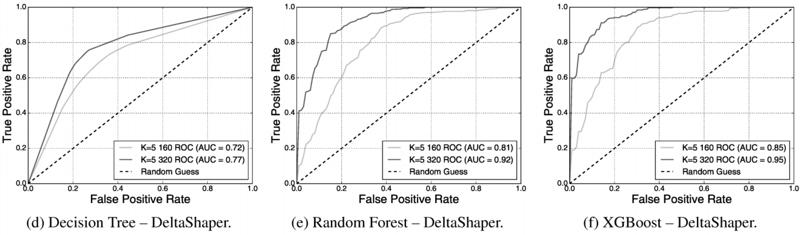
Results & Findings - DeltaShaper
ROC curves w/ Feature Set 2: Quantized PLs
AUC = 0.85 (+0.08 than ST)
for 160 X 120 configuration
Quantized PLs Outperform the use of Summary Statistics

Slide 30
Results & Findings - DeltaShaper
ROC curves w/ Feature Set 2: Quantized PLs
AUC = 0.95 (-0.01 than ST)
for 160 X 120 configuration
… Except XGBoost with 320 X 240 Configuration

Slide 31
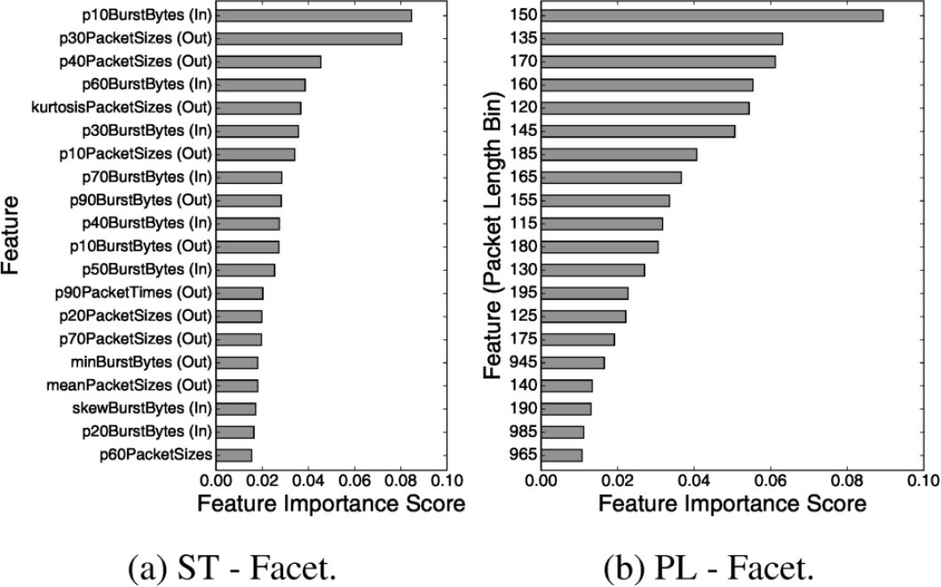
Feature Importance - Facet
TOP 20 Features for ST/PL by XGBoost algorithm, s=50%

Slide 32
Feature Importance - Facet
Facet is more vulnerable to analysis based on PL & Burst
8 Packet Size Features
11 Burst Behavior Features (Total 19 out of TOP 20)

Slide 33
Feature Importance - Facet
Facet covert channels are spotted by PL b/w 115-195 bytes
TOP 10 features are in range of 115-195

Slide 34
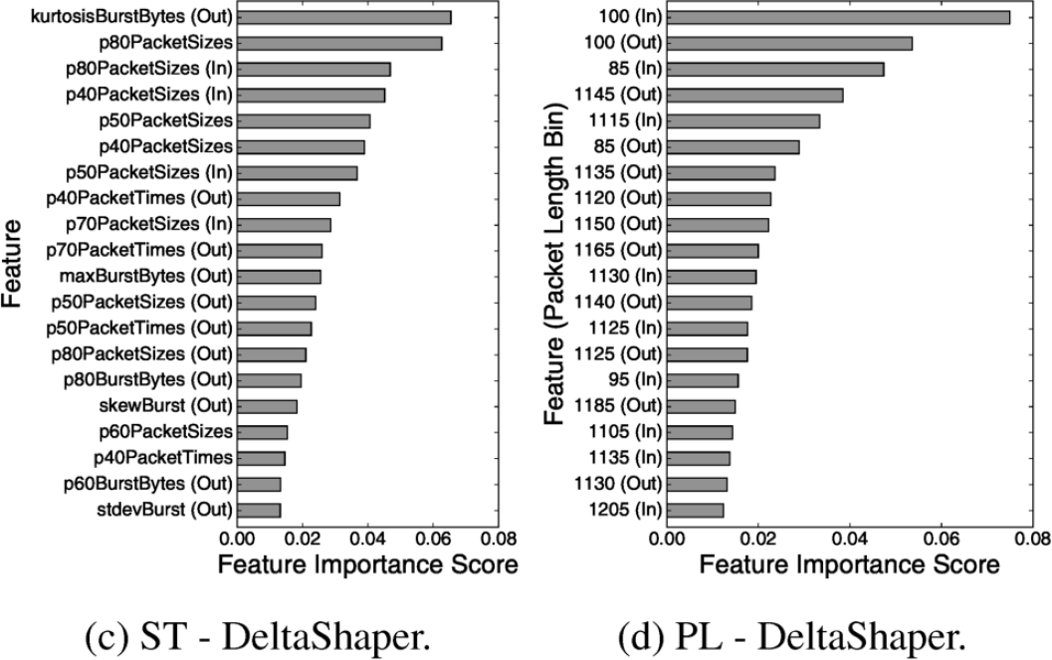
Feature Importance - DeltaShpaer
TOP 20 Features by XGBoost, <320 X 240, 8 X 8, 6, 1>

Slide 35
Feature Importance - DeltaShpaer
DeltaShpaer is more vulnerable to analysis based on PL
7 Packet Size Features (out of TOP 10)

Slide 36
Feature Importance - DeltaShpaer
DeltaShpaer: 85-100, 1105-1205 bytes are important PL
TOP 20 features are
in range of 85-100, 1105-1205
7 Packet Size Features (out of TOP 10)

Slide 37
Alternative Dataset Evaluation
Current dataset is not realistic
Currently: Covert stream is derived by legitimate videos
Problem 1: Correlation among classes occur
Problem 2: Positive class : Negative class = 1 : 1 Unrealistic!
Legitimate
Derive
Covert Stream
Correlated-Unrealistic Dataset

Slide 38
Alternative Dataset Evaluation
Experiment 1
Solution: Covert stream is derived by half of legitimates
Problem 1 Solved: Correlation among classes removed
10-fold cross-validation, 10 times repeated
To prevent the overfitting
Legitimate
Legitimate
Derive Covert Stream
Not Correlated Dataset

Slide 39
Alternative Dataset Evaluation
Experiment 2
Solution: Low pos-to-neg ratio than 1:1 during testing
Problem 2 Solved: Realistic testing environment is built
Training set : Test set = 7 : 3
Pos-to-neg ratio: 1 : 1 (Training set), 1 : 100 (Testing)
Legitimate
Covert Stream
1:1 Ratio Unrealistic Dataset
1:100 Ratio Realistic Dataset

Slide 40
Alternative Dataset Evaluation
Experiment 1
Used XGBoost
AUC=0.95 for DeltaShpaer <320 X 240, 8 X 8, 6, 1>
0.01 less than the original result
AUC=0.99 for Facet s=50%
Experiment 2
Identify 90% of Facet s=50% traffic with FPR of 2%
Identify 90% of DeltaShpaer <320> traffic with FPR of 18%
Only 4% larger than original result
Possible Correlation among classes & sampling ratio do not limit the accuracy of this work

Slide 41
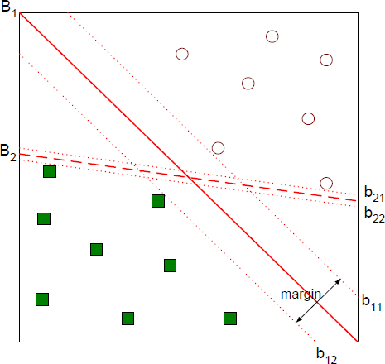
One-class SVMs
Define a boundary between normal/anomaly
Find maximal margin hyperplane

Slide 42
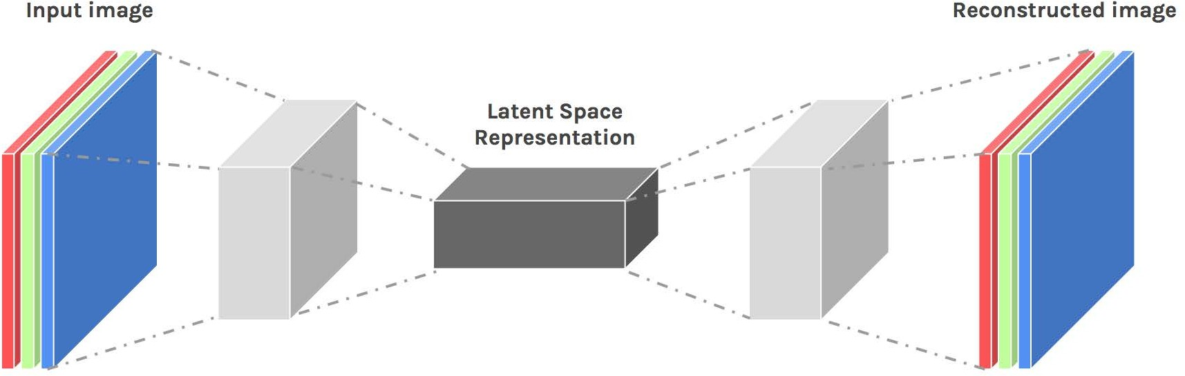
Autoencoders
Approximates the identity function of original
Through a compressed representation of input
Anomaly detection using reconstruction error

Slide 43
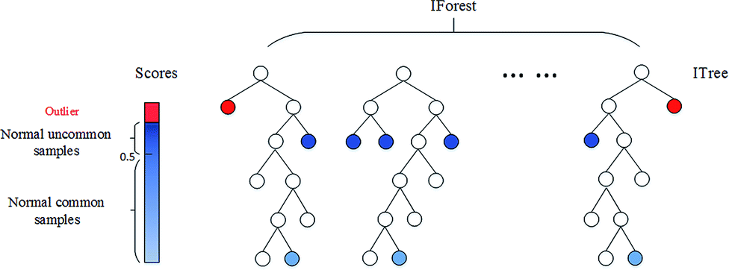
Isolation Forest
Detects outliers
by isolating anomalous samples
Selects a split between its min and max values

Slide 44
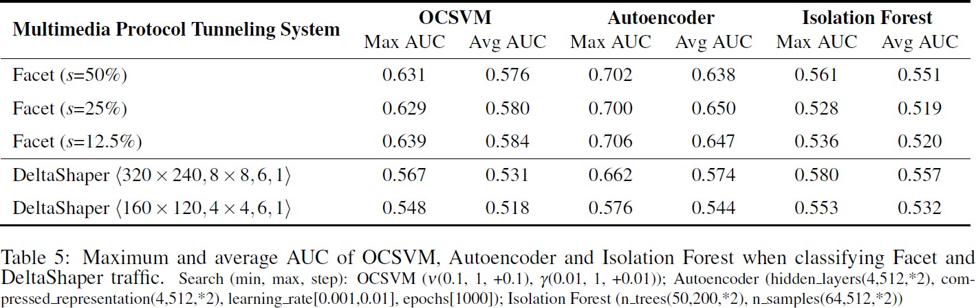
Findings
OCSVM cannot identify covert traffics properly

Slide 45
Findings
Autoencoders have potential to improve
ex) Use autoencoders with more sophisticated structures

Slide 46
Findings
Isolation Forest has no advantage for detecting covert

Slide 47
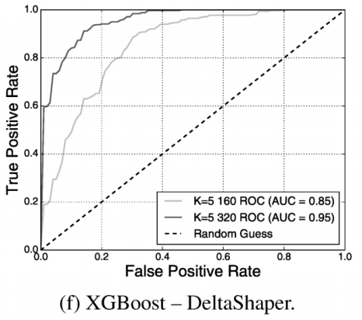
Multimedia Protocol Tunneling
Unobservability claims of existing multimedia protocol tunneling systems were flawed
Supervised ML algorithm can detect covert traffics
Not means multimedia protocol tunneling is inviable
with some configuration, it is hard for adversaries to detect covert channels with low false positive rate (ex: DeltaShpaer <160 X 120>)
0.9
AUC = 0.85
0.3?

Slide 48
Legitimate Traffic Dataset
Adversary cannot collect real world legitimate traffic dataset properly
Because of the multimedia protocol tunneling tools
How can we know which stream is legitimate in advance?
Adversary can construct dataset with their own traffic (like in this paper)
May fail to capture the underlying distribution in wild

Slide 49
Questions

